Slide 1



Introduction to Programming

Slide 2
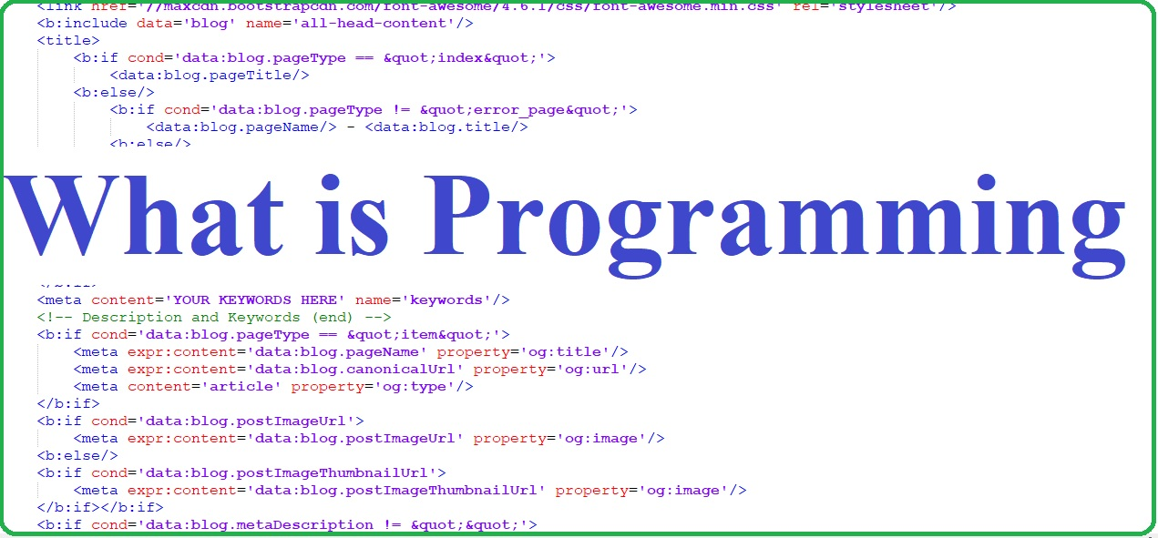

Slide 3

Programming
Programming is the process of giving a set of instructions to a computer to make it able to perform a particular task.

Slide 4
Examples:
Application software (Mobile and Computer Apps)
Operating System
Games
Automation

Slide 5
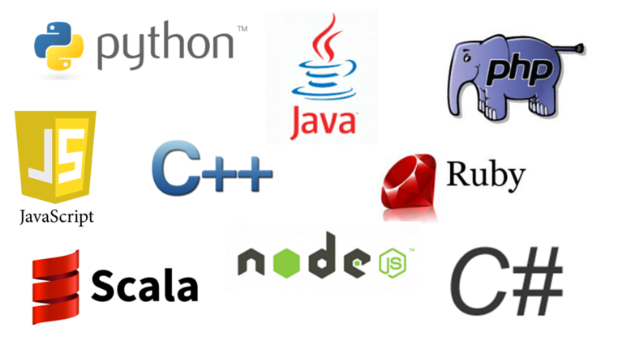
PROGRAMMING LANGUAGES

Slide 6
PROGRAMMING LANGUAGE
It is a computer language programmers use to develop software programs, scripts, or other sets of instructions for computers to execute. Although many languages share similarities, each has its own syntax.

Slide 7
PROGRAMMING LANGUAGES
1. Python - is widely regarded as a programming language that’s easy to learn, due to its simple syntax, a large library of standards and toolkits
2. Javascript –JavaScript is the most popular programming language for building interactive websites

Slide 8
PROGRAMMING LANGUAGES
3. Java - Java is the programming language most commonly associated with the development of client-server applications, which are used by large businesses around the world.
4. C# - developed by Microsoft that runs on the .NET Framework.
5. C++ - is an extension of C. It can be used to create high-performance applications.
6. – PHP - widely used for server-side web development, when a website frequently requests information from a server.

Slide 9
PROGRAMMING ALGORITHM
procedure or formula used for solving a problem
It should contain an Input, Process and an Output. Depending on the problem to be solved.

Slide 10
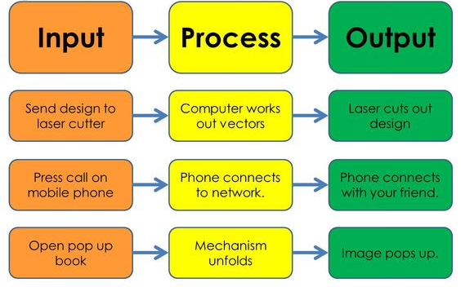
IPO MODEL

Slide 11
VARIABLES
Math: A symbol (usually a letter) that represents any number
Programming: a letter or word that serve as a temporary storage that represents any value.

Slide 12
PROGRAMMING PROBLEM 1 (Algorithm)
Create a program that will display the sum of 2 numbers inputted by the user.
Algorithm:
Declare 3 variables, 2 for the ADDENDS and 1 for the SUM.
Let the user Input the Addends.
Perform the ADDITION between the ADDENDS and assign it to the SUM.
Display the SUM.

Slide 13
PSEUDOCODE
is a step-by-step written outline of your code that you can gradually transcribe into programming language.
It is also called false called because it tends to look like a programming language but can still be understood by a person that has little understanding in programming.

Slide 14
PROGRAMMING PROBLEM 1 (PSEUDOCODE)
Create a program that will display the sum of 2 numbers inputted by the user.
Let numOne = 0, numTwo = 0 and sum = 0
Input numOne and numTwo
sum = numOne + numTwo
Output sum

Slide 15
Try this!
Create a program that will display the average of 2 numbers inputted by the user.

Slide 16
Create a program that will display the average of 2 numbers inputted by the user.
Pseudocode
Pseudocode 1:
Let numOne = 0, numTwo =0 , sum =0 and ave =0
Input numOne and numTwo
Sum = numOne + numTwo
Ave = sum / 2
Output - ave

Slide 17
Create a program that will display the average of 2 numbers inputted by the user.
Pseudocode
Pseudocode 2:
Let numOne = 0, numTwo =0 , sum =0 and ave =0
Input numOne and numTwo
Ave = (numOne + numTwo) / 2
Output - ave

Slide 18
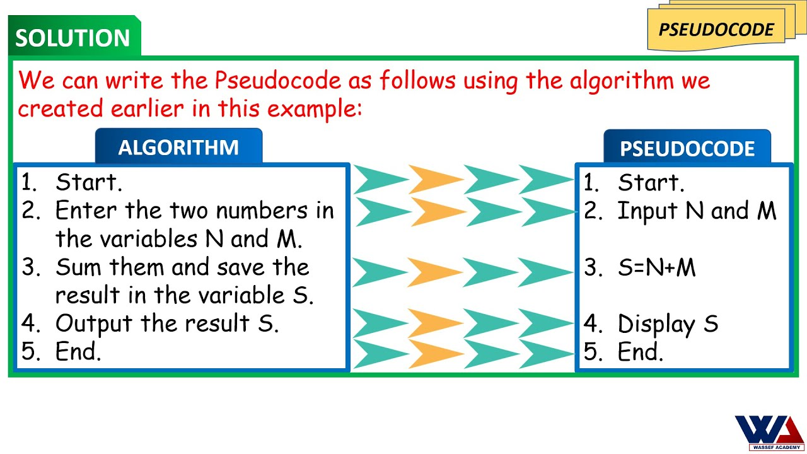
Pseudocode

Slide 19
FLOWCHART
A method that allows a programmer to represent algorithm in a Diagram or an illustration.
It represents the sequence of algorithm by using standard graphic symbols that will represent the INPUT, PROCESS and the OUTPUT.

Slide 20
FLOWCHART BASIC SYMBOLS
These are the commonly used symbols to create a diagram that represents an algorithm that a computer program follows.
START
or
END
PREPARATION
PROCESS
INPUT
or
OUTPUT
DECISION
Ellipse
Hexagon
Rectangle
Parallelogram
Diamond

Slide 21
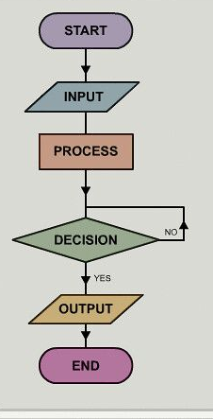

Slide 22
Create a flowchart
Create a program that will display the sum of 2 numbers inputted by the user.
Let numOne = 0, numTwo = 0 and sum = 0
Input numOne and numTwo
sum = numOne + numTwo
Output sum

Slide 23
Flowchart
START
numOne = 0;
numTwo = 0
Sum = 0
INPUT
numOne
numTwo
sum = numOne + numTwo
OUTPUT sum
END

Slide 24
Wrap up
Programming is a series of instruction that directs a computer to perform a task.
Programming Algorithm set of instructions/ rules to be followed by a computer.
Variables - a letter or word that serve as a temporary storage that represents any value.
Pseudocode is a step-by-step written outline of your code that you can gradually transcribe into programming language.
Flowchart - A method that allows a programmer to represent algorithm in a Diagram or an illustration.
Programming is a matter of mindset and willingness
Enjoy the learning process.

Slide 25
Thank you!

